Slide 2
Instructions
I love living in the toy shop – there are so many different toys!
Can you help me compare the sets of toys?
Which sets have more?
Which sets have fewer?
Click on the sets of pictures to check your answers.
Remember to listen to the question carefully.
Start

Slide 3
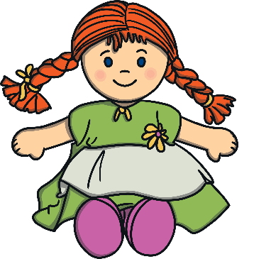
Which set contains more toys?
back
next
Correct! There are more building bricks than dolls.
Try again.

Slide 4
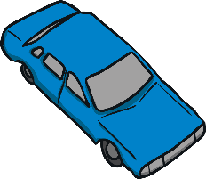
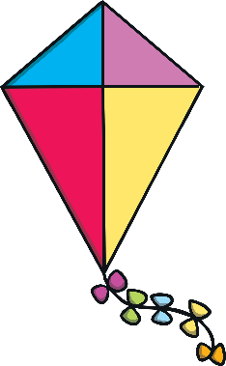
Which set contains more toys?
back
next
Correct! There are more cars than kites.
Try again.

Slide 5
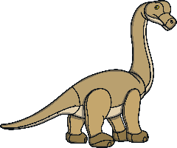
Which set contains more toys?
back
next
Correct! There are more dinosaurs than books.
Try again.

Slide 6
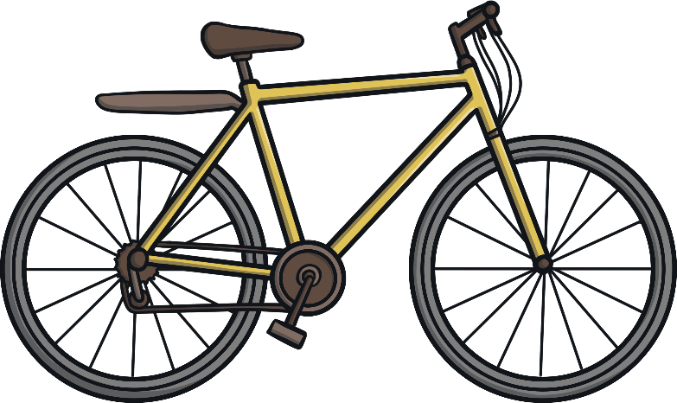
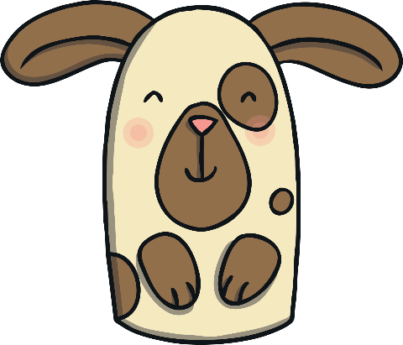
Which set contains more toys?
back
next
Correct! There are more puppets than bikes.
Try again.

Slide 7
Which set contains more toys?
back
next
Correct! There are more crayons than footballs.
Try again.

Slide 8
Which set contains fewer toys?
back
next
Correct! There are fewer yo-yos than marbles.
Try again.

Slide 9
Which set contains fewer toys?
back
next
Correct! There are fewer skipping ropes than robots.
Try again.

Slide 10
Which set contains fewer toys?
back
next
Correct! There are fewer boats than paintbrushes.
Try again.

Slide 11
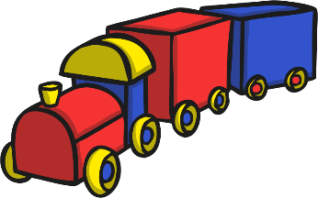
Which set contains fewer toys?
back
next
Correct! There are fewer trains than action figures.
Try again.

Slide 12
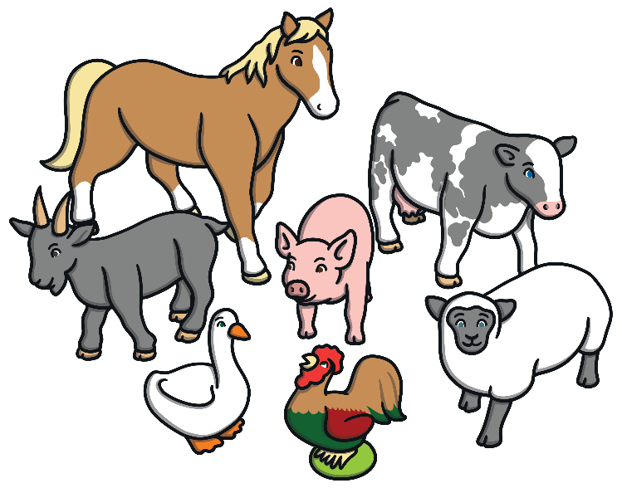
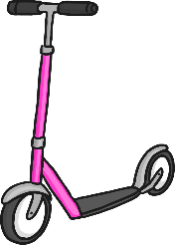
Which set contains fewer toys?
back
next
Correct! There are fewer scooters than animals.
Try again.

Slide 13
Can you say two sentences to compare the sets of toys using the words more and fewer?
back
next
Tell a friend your sentences.
Try starting one sentence ‘There are more’ and the other sentence with ‘There are fewer’.

Slide 14
Can you say two sentences to compare the sets of toys using the words more and fewer?
back
finish
Tell a friend your sentences.
Try starting one sentence ‘There are more’ and the other sentence with ‘There are fewer’.

Slide 15
The End
Well done – super comparing!
Play again

